Slide 1


Introduction to Convolutional Neural Networks
Mustafa Alghali
26 Oct 2018

Slide 2
Outline
Why Deep Learning ?
1
Why Convolution ?
2
Convolutional Networks
3
Applications
4
Popular architectures
5
Demo
6

Slide 3
Outline
Why Deep Learning ?
1
Why Convolution ?
2
Convolutional Networks
3
Applications
4
Popular architectures
5
Demo
6

Slide 4
Deep learning
Is a branch of machine learning based on a set of algorithms that attempt to model high level abstractions in data.

Slide 5
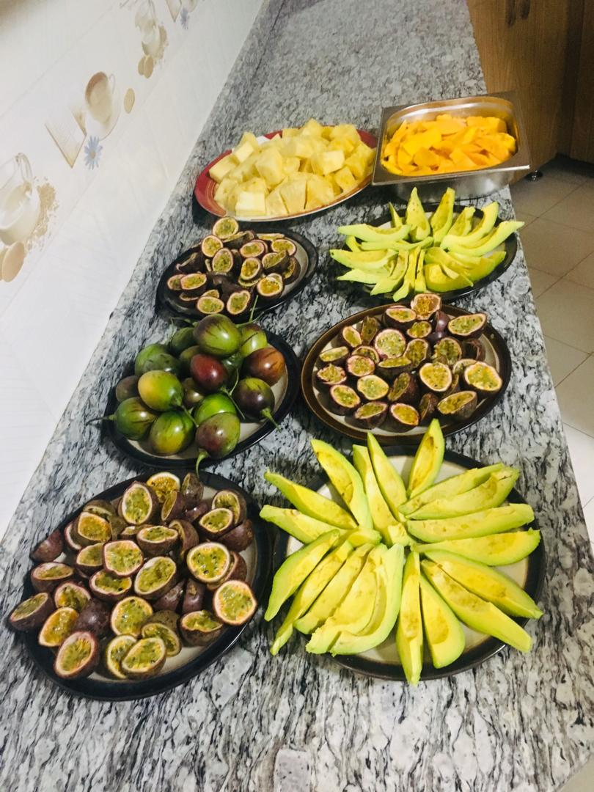
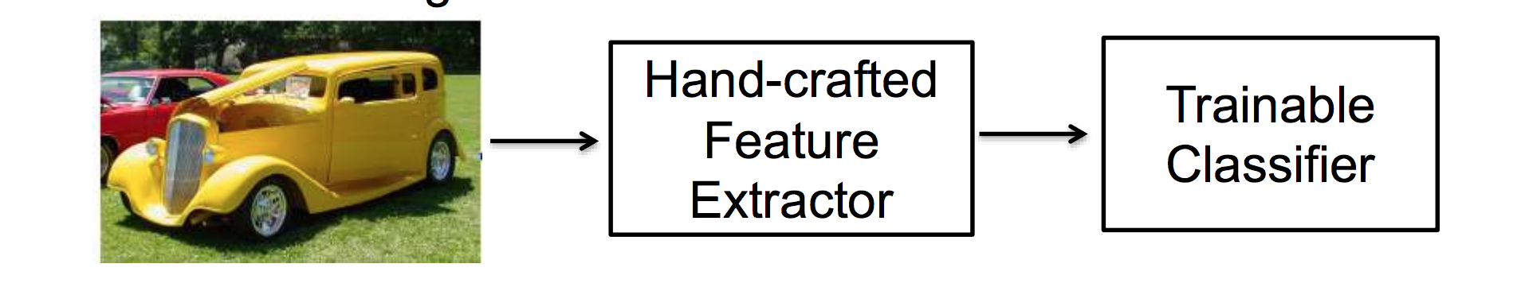
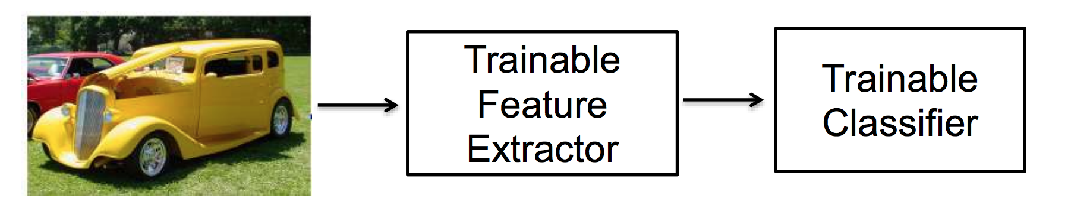
Traditional pattern recognition

Slide 6
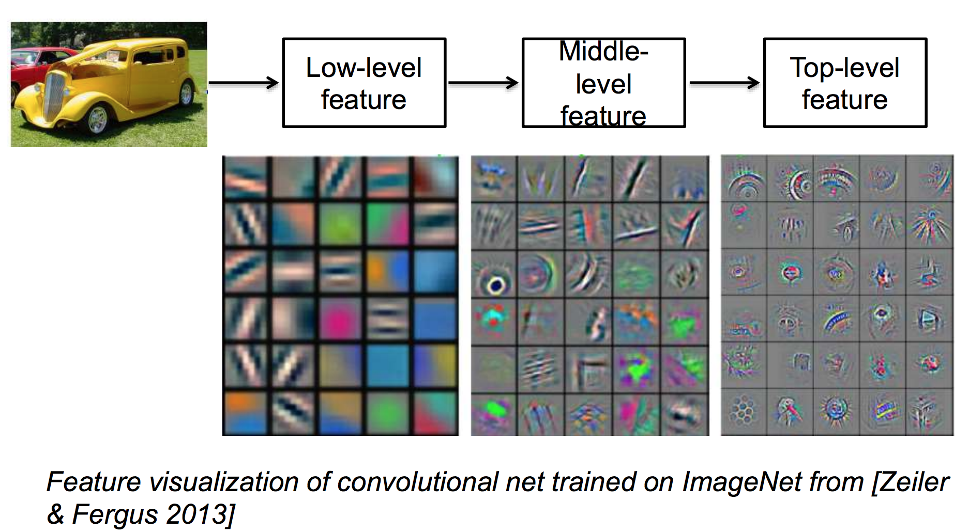
Learning feature representations

Slide 7
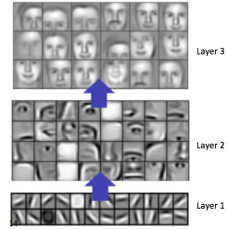
Learning feature representations
Translating the data into compact intermediate representations
akin to principal components:
Drive layered structures which remove redundancy in representation

Slide 8
Research goal
Make better representations and create models to learn these representations from large-scale unlabeled data.

Slide 9
Outline
Why Deep Learning ?
1
Why Convolution ?
2
Convolutional Networks
3
Applications
4
Popular architectures
5
Demo
6

Slide 10
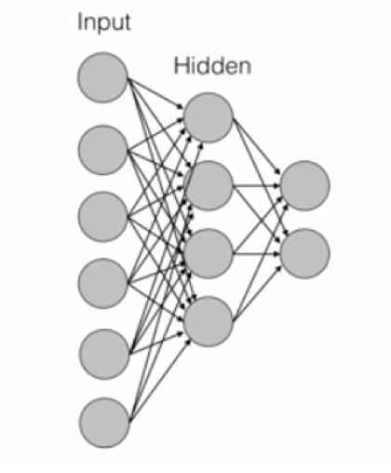
Why convolution
MNIST Dataset: 28x28 pixels (784 pixels)
First Layer weights: ~ 78k parameters

Slide 11
Why convolution
MNIST Dataset: 28x28 pixels (784 pixels)
First Layer weights: ~ 78k parameters
In a typical Image: 256 x 256 (65,000 pixels)
First Layer weights: 560k parameters

Slide 12
Why convolution
MNIST Dataset: 28x28 pixels (784 pixels)
First Layer weights: ~ 78k parameters
In a typical Image: 256 x 256 (65,000 pixels)
First Layer weights: 560k parameters
Too many parameters, unscalable to real images

Slide 13
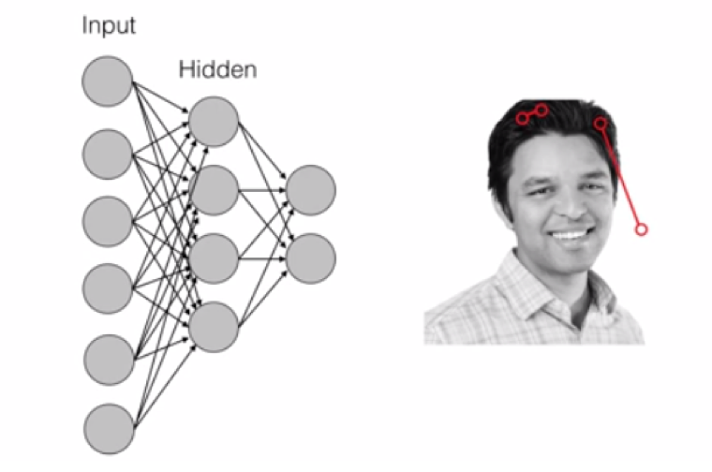
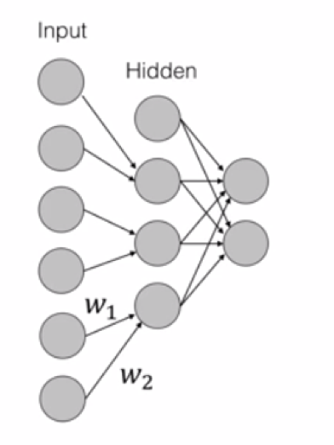

Spatial features
VS

Slide 14
Why convolution
A two-dimensional
array of pixels
CNN
X or O

Slide 15
Why convolution
CNN
X
CNN
O

Slide 16
Trickier cases
CNN
X
translation
scaling
rotation
weight
CNN
O

Slide 17
Deciding is hard ?
?
=

Slide 18
Computers are literals
?
=

Slide 19
What computer see

Slide 20
Computers are literals
=
x

Slide 21
Our target is to match image pieces!
=
=
=

Slide 22
Concept of features

Slide 23
Concept of features

Slide 24
Filtering: The math behind the match
Line up the feature and the image patch.
Multiply each image pixel by the corresponding feature pixel.
Add them up.
Divide by the total number of pixels in the feature.

Slide 25
Convolution process
1 x 1 = 1

Slide 26
Convolution process
1 x 1 = 1

Slide 27
Convolution process
-1 x -1 = 1

Slide 28
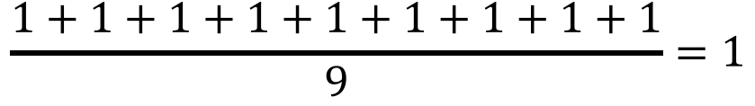
Convolution process
$$\frac{1+1+1+1+1+1+1+1+1}{9}=1$$

Slide 29
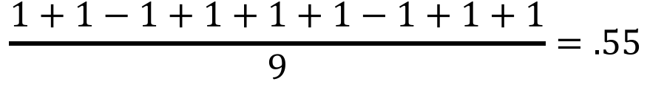
Convolution process
$$\frac{1+1−1+1+1+1−1+1+1}{9}=.55$$
.55

Slide 30
Convolution process
=
Demo 0

Slide 31
Multi-features
=
=
=

Slide 32
Convolution layer
One image becomes a stack of filtered images

Slide 33
Outline
Why Deep Learning ?
1
Why Convolution ?
2
Convolutional Networks
3
Applications
4
Popular architectures
5
Demo
6

Slide 34
Q: So How we learn these filters using NN ?

Slide 35
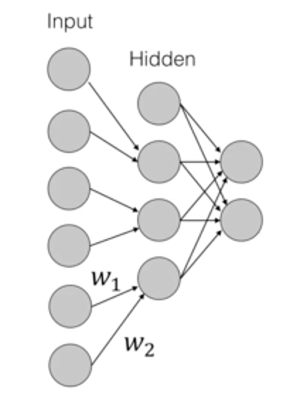
Filter weights -→ NN weights

Slide 36
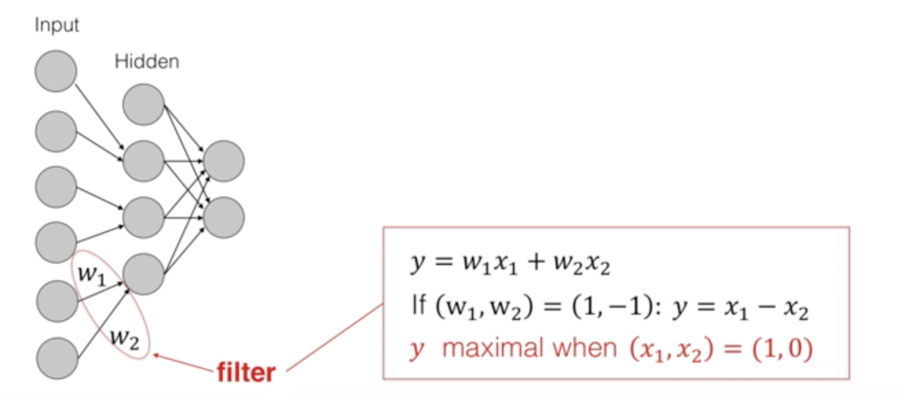
Filter weights -→ NN weights

Slide 37
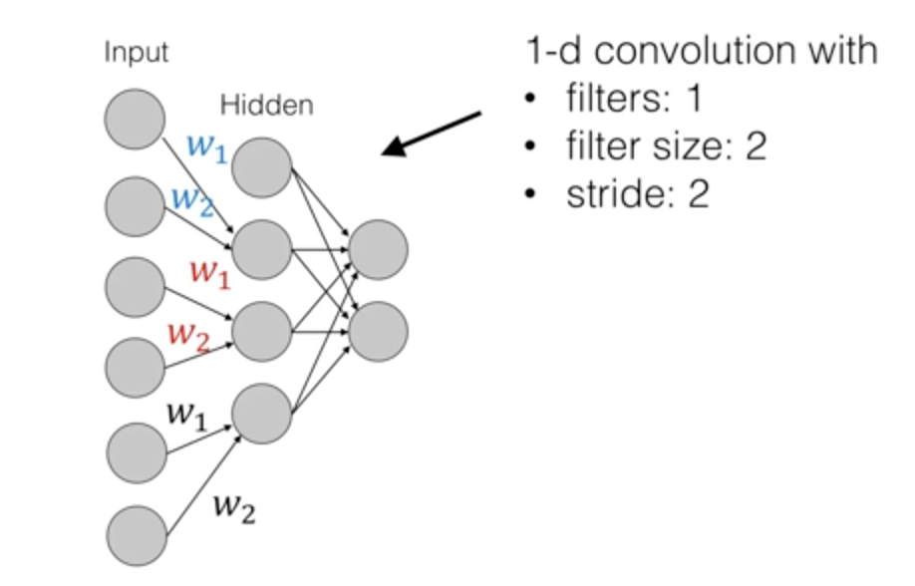
Filter weights -→ NN weights

Slide 38
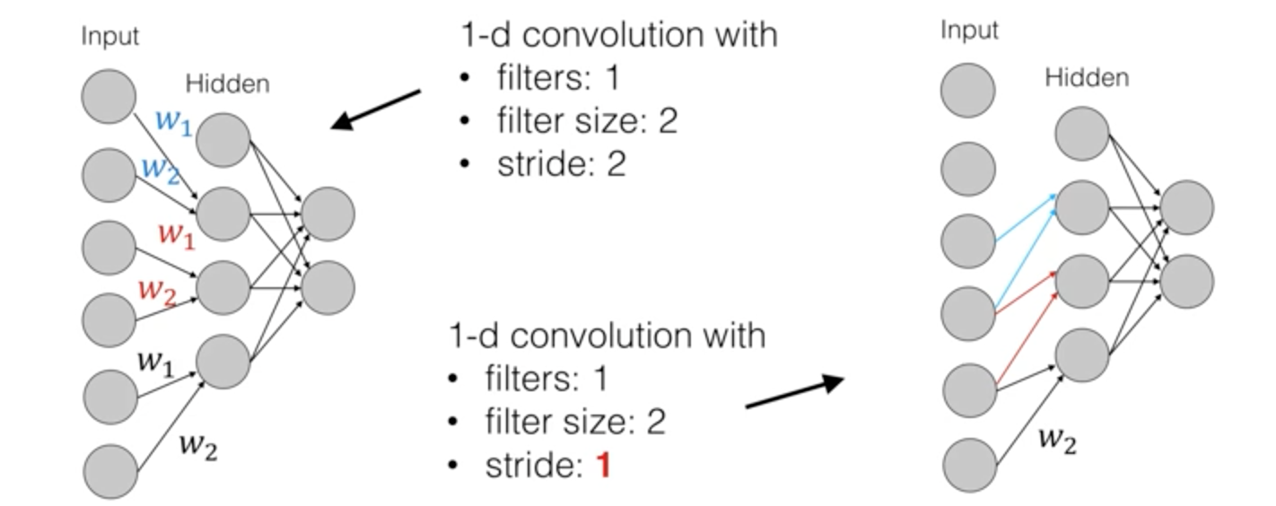
Filter weights -→ NN weights

Slide 39
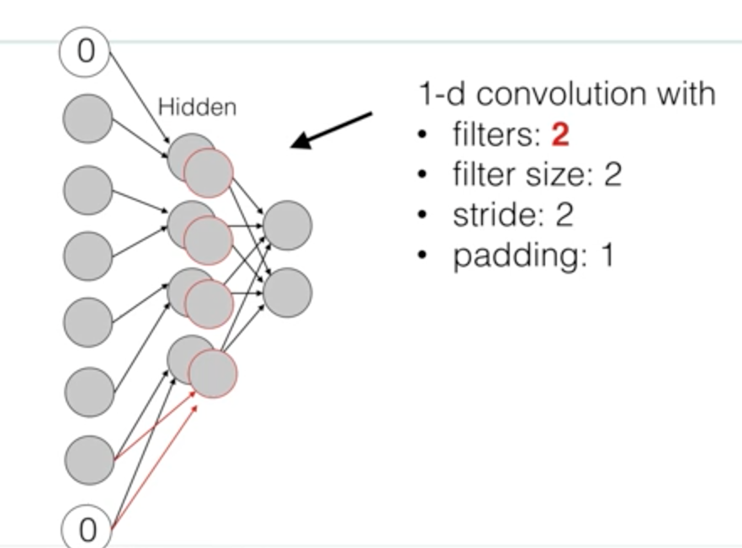
Filter weights -→ NN weights

Slide 40
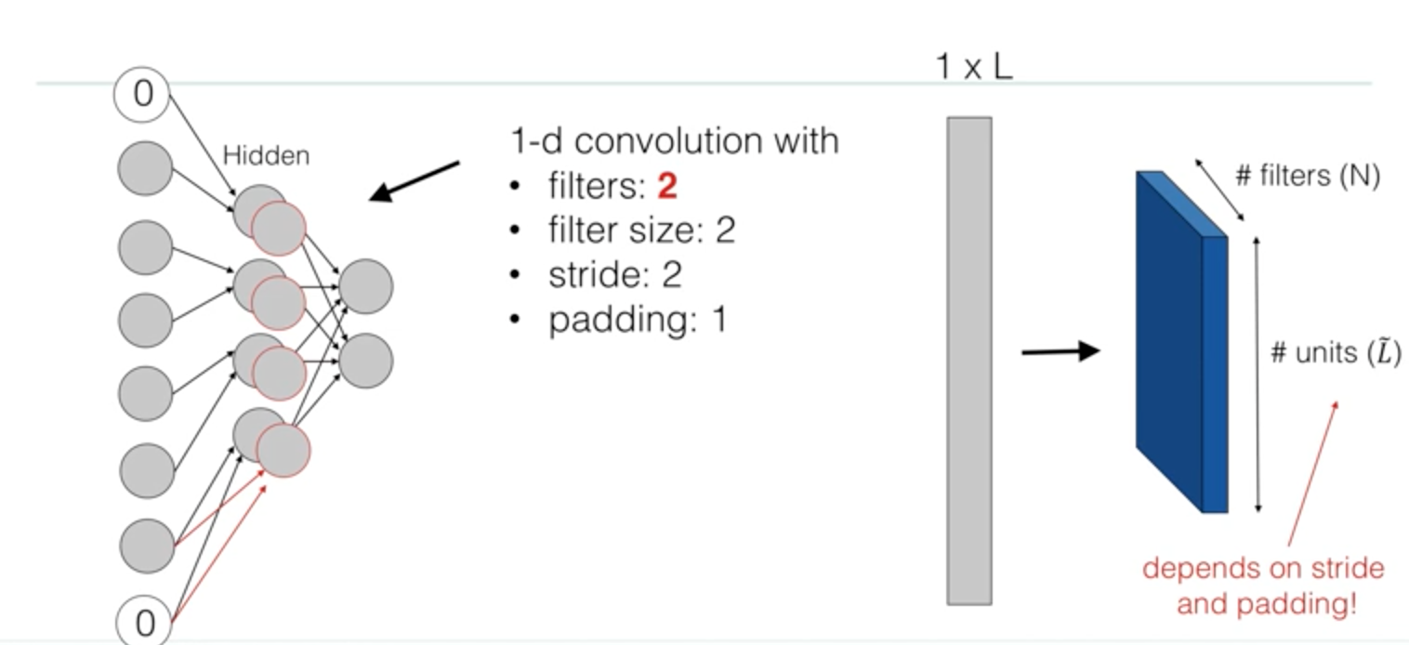
1-D convolution

Slide 41
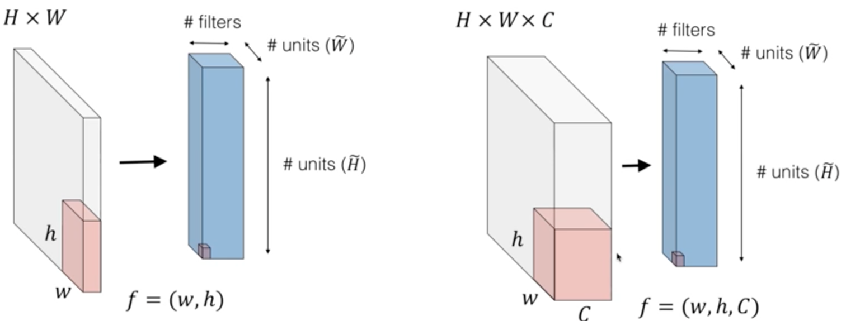
2-D convolution

Slide 42
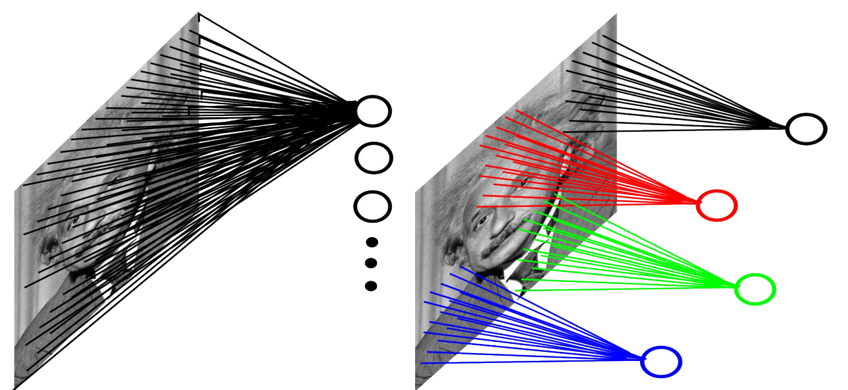

Slide 43
Pooling
Pick a window size (usually 2 or 3).
Pick a stride (usually 2).
Walk your window across your filtered images.
From each window, take the maximum value.

Slide 44
Pooling
maximum

Slide 45
Pooling
maximum

Slide 46
Pooling
maximum

Slide 47
Pooling
maximum

Slide 48
Pooling
max pooling

Slide 49
Pooling

Slide 50
Pooling
A stack of images becomes a stack of smaller images.

Slide 51
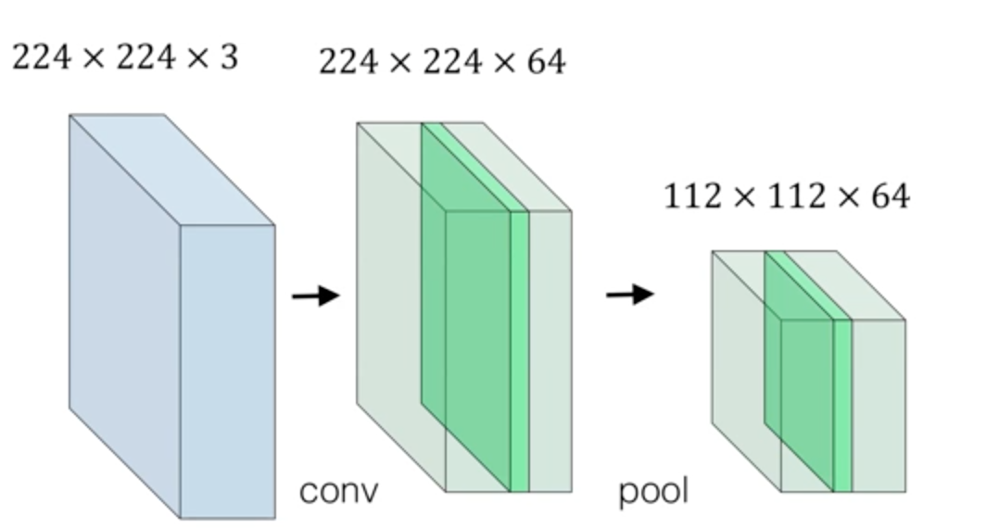
Pooling (sub-sampling)

Slide 52
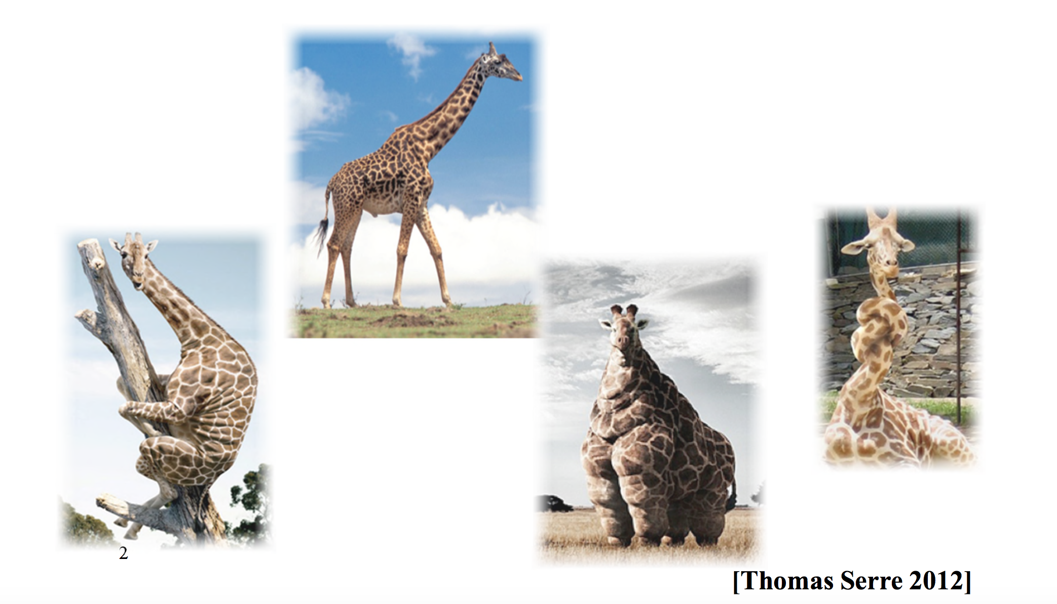
Pooling – invariance

Slide 53
Normalization

Slide 54
Normalization

Slide 55
Normalization

Slide 56
Normalization

Slide 57
Normalization

Slide 58
Relu VS Sigmod
Relu: Reduce the likelihood of the gradient to vanish
Sigmoid: tend to vanish gradient
Relu : tend to blow up activation (a is the output itself)
Relu: More computationally efficient to compute than Sigmoid
Relu : Dying Relu problem
Demo 1
Demo 2

Slide 59
Layers get stacked
Convolution
ReLU
Pooling

Slide 60
Layers get deep stacked
Convolution
ReLU
Convolution
ReLU
Pooling
Convolution
ReLU
Pooling

Slide 61
Learned features How to classify ?

Slide 62
Fully connected layer

Slide 63
Fully connected layer
X
O

Slide 64
Fully connected layer
X
O

Slide 65
Fully connected layer
X
.92
O
.51

Slide 66
Fully connected layer
X
O

Slide 67
Fully connected layer
X
O

Slide 68
Fully connected layer
X
O

Slide 69
Putting it all together
.92
X
Convolution
ReLU
Fully
connected
Fully
connected
Convolution
ReLU
Convolution
ReLU
Pooling
Pooling
O
.51

Slide 70
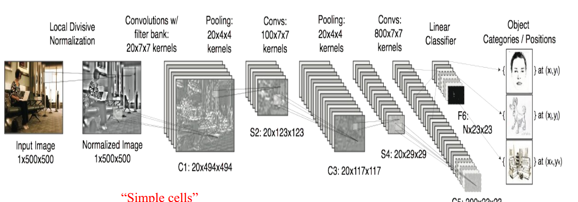
Putting it all together

Slide 71
Putting it all together
.92
X
Convolution
ReLU
Fully
connected
Fully
connected
Convolution
ReLU
Convolution
ReLU
Pooling
Pooling
O
.51
Demo 3

